Slide 1



Speech Denoising: a Noise2Noise Capstone Project Phase A #A-23-2-R-10
Students:
Omri Cohen
Eliav Shabat
Supervisors
Dr. Renata Avros
Prof. Zeev Volkovich

Slide 2
Table of contents
1
2
3
Introduction
Background
Expected Achievements
4
5
6
Research process
Evaluation Plan
Potential challenges

Slide 3

1
Introduction

Slide 4

The problem
Speaker recognition
Interference
Performed by a set of speaker characteristics comparison usually from audio recordings or from a military tactical communication.
Accuracy and performance are based on the audio quality.
In Walkie-Talkie communication systems (e.g. ‘BNET’ in RAFAEL) there are a lot of interferences such as: chatters in the background, audio signal resampling, static interference, white noise etc.
Notes:
אליאב

Slide 5
The solution
Denoise recordings - As a solution to the problem, the project proposes a model that aims to remove noise from recordings of a B-net walkie-talkie using a learning machine techniques. The model will provide clean recordings that will be used by Rafael for training a speaker recognition model.
N2N algorithm - The chosen approach for implementing the solution is N2N. A neural network-based method originally developed for image denoising and then denoising.
Notes:
עומרי
1. הפרויקט מציע פתרון באמצעות הסרת רעשים עם מכונה לומדת.
2. יעזור לרפאל ללמד את המודל שלהם לזיהוי דובר.
3. בחרנו באלגורית N2N (היה לתמונה, היום לרעש)
4. בהמשך נרחיב על הארכיטקטורה Unet והיתרונות שלו.

Slide 6
2
Background

Slide 7



Introduction to denoising
Training
Denoising
Machine learning
The network learns to identify the underlying patterns and relationships between the noisy input and the corresponding clean output.
Perform a series of mathematical operations (such as FFT or STFT) and transformations, using the learned patterns, to separate the speech signal from the noise
Using a network that learns the characteristics of the noise and thus removes it accurately.
Notes:
עומרי
אסביר באופן כללי על תהליך הסרת רעש באמצעות מכונה לומדת
שימוש ברשתות לומדות יכול לייעל את הסרת הרעש
2. למידת מאפייני הרעש
3. ביצוע פעולות מתמטיות והעברה ברשת להפרדה של הרעש מהדיבור

Slide 8
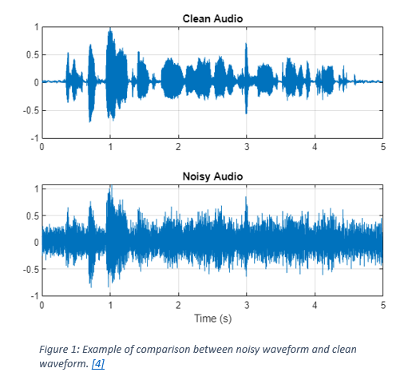
Introduction to denoising

Slide 9
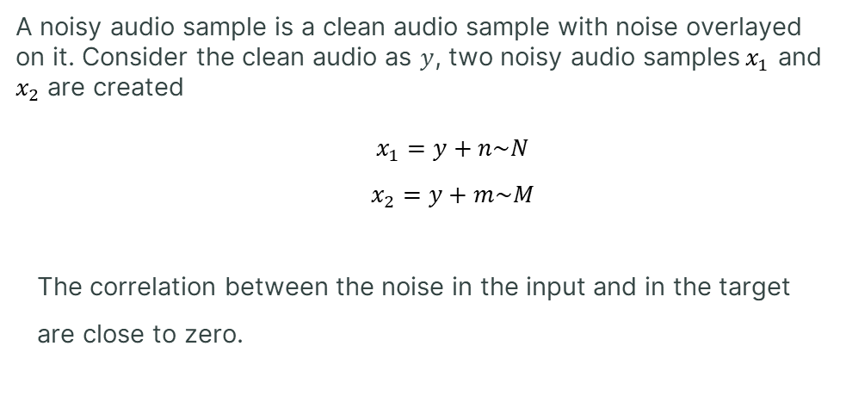
Noisy Audio Samples
A noisy audio sample is a clean audio sample with noise overlayed on it. Consider the clean audio as $y$, two noisy audio samples${ x}_{1}$ and $x_{2}$ are created
$x_{1}=y+n\sim N$
$x_{2}=y+m\sim M$
The correlation between the noise in the input and in the target
are close to zero.
Notes:
עומרי
דגימה רועשת היא דגימה שהוספנו עליה שכבת רעש.
מכל דגימה נקיה נייצר שתי דגימות רועשות.
3. ישמשו לצורך השוואה והבנה של מה הרעש ומה הדיבור

Slide 10
Noise2Noise (N2N) Approach
Notes:
אליאב

Slide 11
3
Expected Achievements

Slide 12
Expected Achievements
Ability to achieve good training results even with limited clean training data.
Enhance speaker's sound quality through eliminating noise from the signal.
Products:
Comprehensive summary & Theoretical insights.
Algorithm implementation.
Visualization of achieved outcomes.
Notes:
אליאב

Slide 13
4
Research process

Slide 14



N2N Advantages (against N2C)
Cost Efficiency
Requires relatively small amount of clean data
Potential for Robustness
N2N is trained on noisy data so it is more robust to noise in real-world usage.
By using noisy data, N2N can potentially reduce the cost and effort involved in preparing the training dataset.
In many real-world scenarios, obtaining clean data can be challenging.
N2N is that it requires relatively small amount of clean data (noise-free).
Notes:
עומרי
איסוף של הרבה הקלטות נקיות יכול להיות מאתגר ולא אפשרי
N2N מאפשר איסוף של פחות הקלטות נקיות
יכול להיות יותר עמיד ויציב במקרים של רעשים מהעולם האמיתי
מחיר של איסוף דגימות נקיות גבוה
הכנת הדאטה לאימון יכולה לעלות פחות

Slide 15



Datasets and Data Generation for N2N training and evaluation
Collection of existing audio recordings of a BNET radio from RAFAEL, recording of additional samples. Using existing data sets from existing packages and transferring them through a BNET radio.
Manipulating the recordings using Pydub library
Complying the manipulated recordings with predefined metrics such as SNR and PESQ.
Notes:
עומרי
נבצע איסוף של הקלטות מרפאל וניצור הקלטות בעצמנו
נעביר הקלטות נקיות דרך BNET
נבצע מניפולציות על ההקלטות
נבדוק שהן עומדות במטריקות

Slide 16
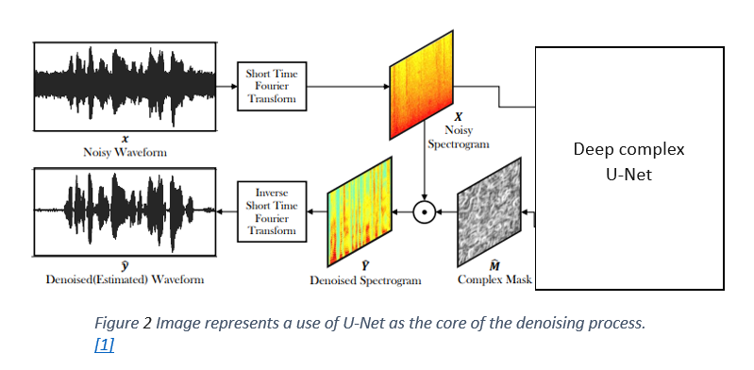
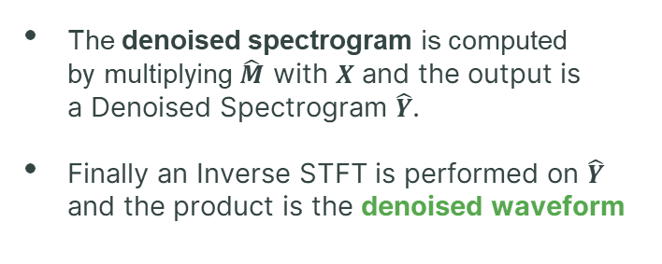
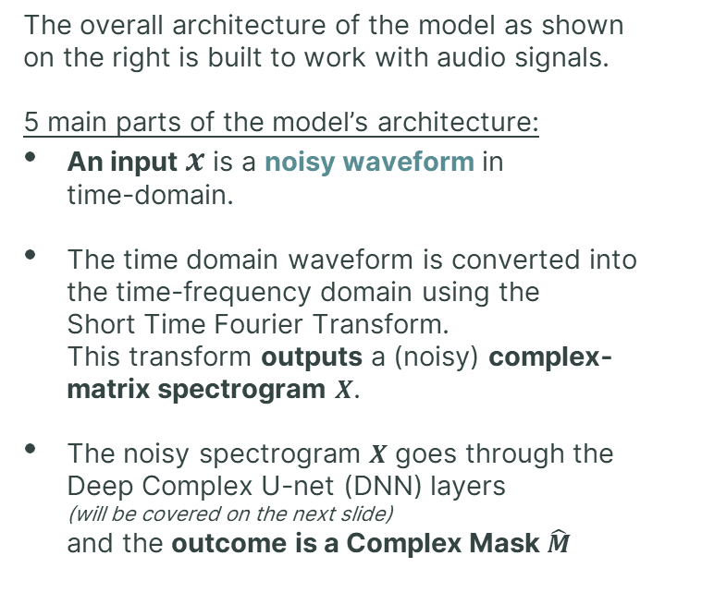
Model architecture
The overall architecture of the model as shown on the right is built to work with audio signals.
5 main parts of the model’s architecture:
An input $x$ is a noisy waveform in time-domain.
The time domain waveform is converted into the time-frequency domain using the Short Time Fourier Transform. This transform outputs a (noisy) complex- matrix spectrogram $X$.
The noisy spectrogram $X$ goes through the Deep Complex U-net (DNN) layers (will be covered on the next slide) and the outcome is a Complex Mask $\hat{M}$
The denoised spectrogram is computed by multiplying $\hat{M}$ with $X$ and the output is a Denoised Spectrogram $\hat{Y}$.
Finally an Inverse STFT is performed on $\hat{Y}$ and the product is the denoised waveform
Notes:
אליאב

Slide 17
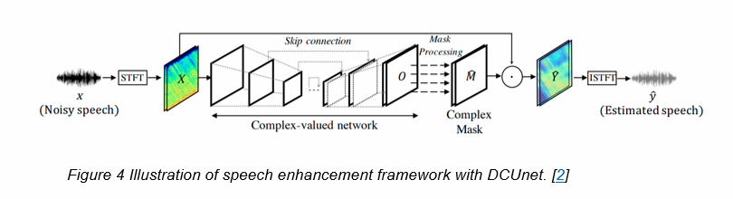
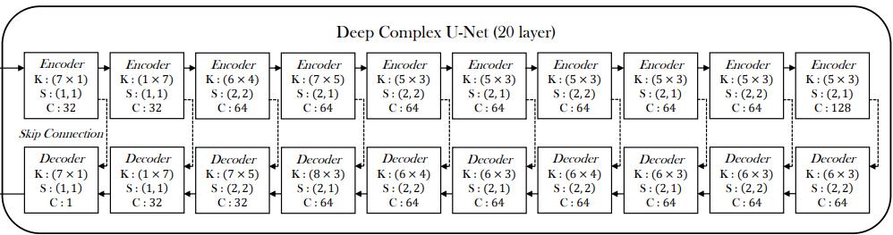
Network architecture – DC U-Net
DC U-net processes both phase and magnitude spectrograms, resulting in enhanced audio reconstruction with better precision and better results in denoising.
The encoding and decoding stages of the network consist of a complex convolution with specified kernel sizes, stride sizes, and output channels as described by the picture bellow.
The skip connections between the encoder and decoder facilitate the combination of low-level features from the encoder with high-level features from the decoder.
Activation Function is applied to both real and imaginary parts of the neuron -
Notes:
אליאב
DCU-Net serves as the core basis for our project.
Its ability to capture and process complex patterns in the audio data helps in better noise removal

Slide 18
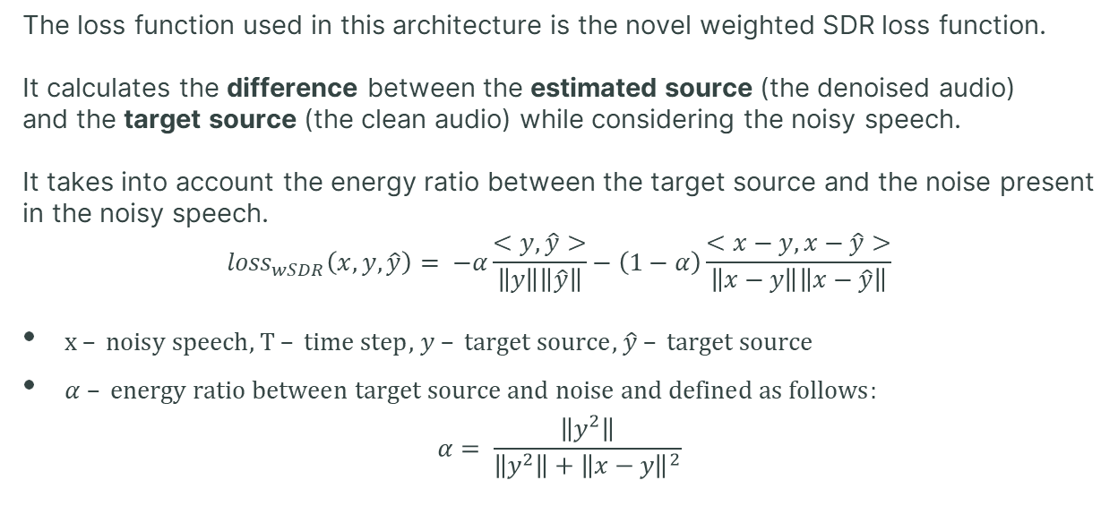
Network architecture – Loss function
The loss function used in this architecture is the novel weighted SDR loss function.
It calculates the difference between the estimated source (the denoised audio) and the target source (the clean audio) while considering the noisy speech. It takes into account the energy ratio between the target source and the noise present in the noisy speech.
$${loss}_{wSDR}\left(x,y,\hat{y}\right)= −α\frac{<y,\hat{y}>}{\left\|y\right\|\left\|\hat{y}\right\|}−\left(1−α\right)\frac{<x−y,x−\hat{y}>}{\left\|x−y\right\|\left\|x−\hat{y}\right\|}$$
$x – noisy speech$, $T – time step$, $y – target source$, $\hat{y} – target source$
$α – energy ratio between target source and noise and defined as follows:$ $α= \frac{\left\|y^{2}\right\|}{\left\|y^{2}\right\|+{\left\|x−y\right\|}^{2}}$
Notes:
עומרי 1. פונקציית הפסד SDR
2. מחשבת מרחק בין מקור לידע (לדבר עם אליאב)
3. לבדוק מה המטריקות של ההשוואה

Slide 19
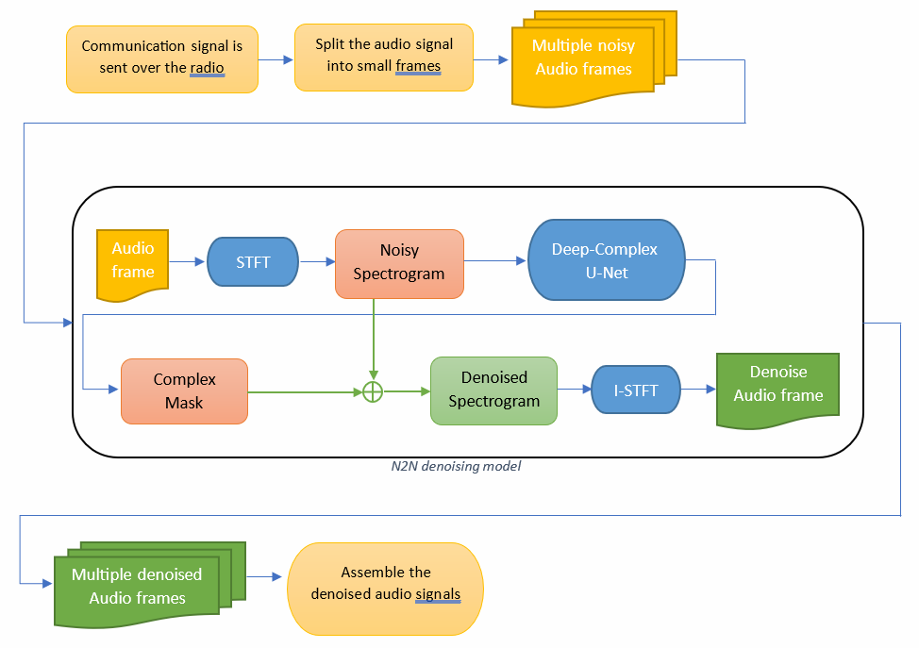
Flow diagram
Notes:
אליאב
תהליך של הסרת רעש לאחר אימון המודל
הכנה של הקלט לאלגוריתם
מעבר בSTFT
מעבר ברשת
מעבר בSTFT הפוך
סידור מחדש של המידע לקובץ נקי

Slide 20



Gui
The interface will be written using Python and "tkinter" library.
N2N denoiser
N2N denoiser
N2N denoiser
Welcome to N2N denoiser.
Please choose audio file or audio folder.
File uploaded: <File name>
File denoised successfully
Play
Play original
Upload file
Denoise
Play Denoise
Upload folder
Back
Back
Back
Notes:
עומרי
הגוי יאפשר הסרת רעש האמצעות הרשת בצורה פשוט למשתמש
הסבר על 3 התמונות

Slide 21
5
Evaluation Plan

Slide 22


Evaluation/Verification Plan
Iterative Product Evaluation and Verification Plan for N2N:
Define general metrics to measure success at each iteration:
Noise removal accuracy – measure accuracy by comparing denoised and original audio signals using Mean Squared Error or Signal-to-Noise Ratio.
Speech recognition accuracy improvement over time
Iteration 1
• Training and Validation: Train the initial Noise2Noise deep learning model using a dataset of noisy audio inputs and corresponding noisy targets.
Validate the model's performance on a separate validation dataset.
• Evaluation:
Measure the accuracy of noise removal by comparing the denoised audio with the original noisy audio using metrics (e.g. MSE or SNR).
Evaluate the speech recognition accuracy on the denoised audio samples using a pre-trained speech recognition model (using PESQ).
• Verification:
Visually assess the quality and level of noise removal by comparing the denoised audio with the original noisy audio.
Notes:
אליאב

Slide 23


Evaluation/Verification Plan
Iterative Product Evaluation and Verification Plan for N2N:
Iteration 2 and Beyond • Training and Validation: Further train the Noise2Noise model using additional (new) noisy audio inputs and corresponding noisy targets. Perform cross-validation to evaluate the model's generalization ability.
• Evaluation: Compare with the previous iteration and continue measure by the proposed metrics
• Verification: Continuously visually assess the quality of denoised audio. Verify the impact on speech recognition accuracy and compare with the previous iteration.
Success Criteria and Iteration Termination:
Success criteria: noise removal accuracy > 90%, speech recognition accuracy > 90%, SNR improvement > 10dB.
Terminate the iterative development process when the success criteria for all metrics are met.
If the success criteria are not met, continue iterating by fine-tuning the model, adjusting hyperparameters, or augmenting the training data.
Notes:
אליאב

Slide 24
6
Potential challenges

Slide 25


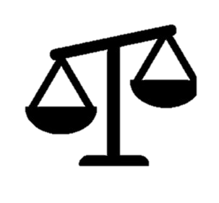
Potential challenges
The data collection should be carried out in coordination with RAFAEL and depends on their resources and capabilities. In addition, there are security aspects that we will have to consider during the collection.
Training the algorithm may require a work environment with powerful enough hardware.
The model was originally trained on white noises and in communication through BNET the noise will be different.
Notes:
עומרי
איסוף מידע מרפאל צריך להיות בתיאום
היבטים אבטחתיים
אימון המודל מצריך סיבת עבודה חזקה
אנחנו לא יודעים איך המודל יגיב להקלטות של B-net

Slide 26
Thanks for listening

